Slide 1
Mode coupling at the transition region and the validity of line-tied boundary conditions
Alex Prokopyszyn, Alan Hood, Andrew Wright

Slide 2
Aims
Show why Fast / Alfvén waves couple at the TR
Test the validity of line-tied BCs
Show they are invalid for highly phase-mixed waves
Notes:
The third aim here is the most important. The key take-away from this seminar is that if the waves become highly phase mixed then this can cause the line-tied boundary condition to become invalid. Or give rise to very large boundary conditions when it shouldn’t.

Slide 3
Structure
Background
Model 1:
Line-tied, pulse
Model 2:
Line-tied, wave train
Model 3:
Line-tied, closed loop
Model 4:
Chromosphere, wave train
Model 5:
Chromosphere, resonant absorption
Conclusion

Slide 4
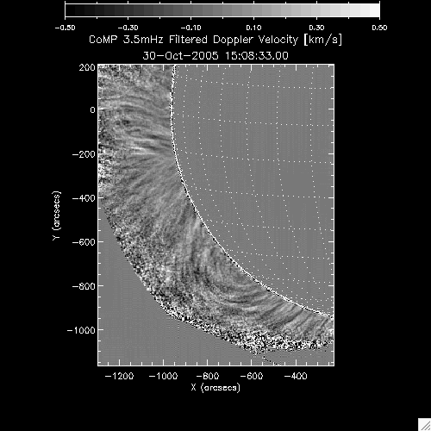
Why study MHD waves?
Ubiquitous
Coronal heating
Seismology
Notes:
Why should we study waves?
I think there are three main reasons to study MHD waves. The first is that we know that waves ubiqutous.

Slide 5
Fast vs. Alfvén waves
3 types of waves
Slow waves, fast waves and Alfven waves
In a uniform medium an Alfven wave will remain an Alfven wave forever
Add video of fast wave and Alfven wave
Fast waves can be evenescent
Dispersion relation

Slide 6
Mode conversion
Can occur via non-linear effects see e.g. verwichte, high beta to low beta see e.g. mclaughlin, gradients in background in Alfven speed → resonant absorption

Slide 7
Mode conversion at the TR
Studied extensively by Halberstadt & Goedbloed analytically closed loops
Arregui 2003 studied numerically
Cally & Hansen (2011); Hansen & Cally (2012) suggest that mode conversion from fast waves to Alfv´en waves at the transition region enables sufficient energy flux to enter the corona

Slide 8
Line-tied boundary conditions
Add VAL
U = 0
Usually valid
Might naively expect the only thing that matters is the lengthscale in the radial direction

Slide 9
Normal mode
f(r,t) = f₀(r)exp(iωt)
Add Morton power spectrum

Slide 10
Model and Equations
Background quantities:
Perturbations:
Unit vectors:
Equations:
$ρ=ρ_{0}$
$B_{0}=B_{0}{\hat{B}}_{0}$
$z$
$y$
$u=u_{x}\hat{x}+u_{⊥}\hat{⊥}$
$b=b_{x}\hat{x}+b_{⊥}\hat{⊥}+b_{∥}{\hat{B}}_{0}$
$x$
$z$
$\hat{⊥}=cos\left(α\right)\hat{y}−sin\left(α\right)\hat{z}$
${\hat{B}}_{0}=sin\left(α\right)\hat{y}+cos\left(α\right)\hat{z}$
α
$ρ_{0}\frac{∂u}{∂t}=j×B_{0}$
$\frac{∂b}{∂t}=∇×\left(u×B_{0}\right)$
$y$
Notes:
We define the z-axis as normal to the solar surface.
The y-axis is defined as the direction in which the magnetic field tilts towards
That leaves the x-direction as the remaining orthogonal direction.

Slide 11
Structure
Background
Model 1:
Line-tied, pulse
Model 2:
Line-tied, normal mode
Model 3:
Chromosphere, normal mode
Summary and conclusions
Notes:
The main goal in this section is to convince you that Alfven waves do indeed couple to fast waves at the transition.

Slide 12
Numerical scheme
Leapfrog algorithm
Based on Rickard and Wright (1994)
Finite-difference
Staggered grid
Second-order accurate

Slide 13
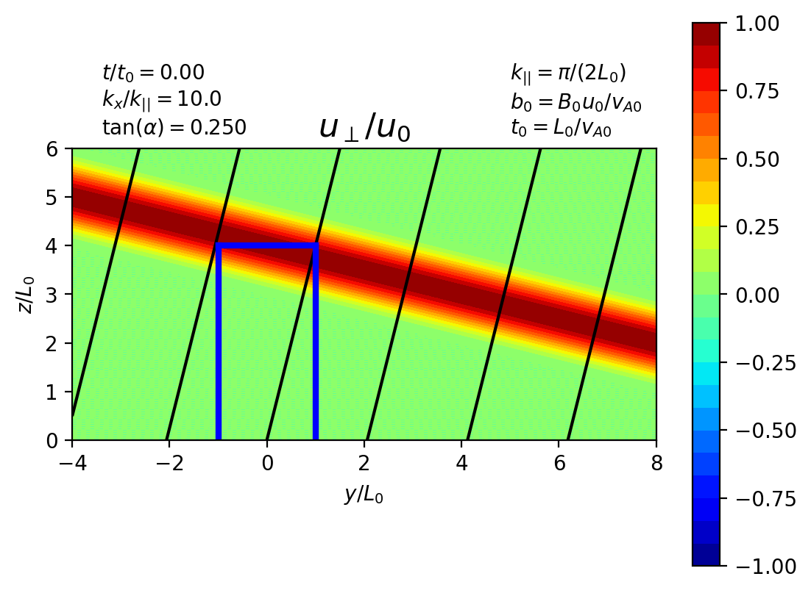
Initial / boundary conditions
Assume that
Initial conditions:
$u_{x},b_{x}∝sin\left(k_{x}x\right)$
$u_{⊥},u_{⊥},b_{∥}∝cos\left(k_{x}x\right)$
$\frac{u_{⊥}}{u_{0}}=\frac{b_{⊥}}{b_{0}}=\left\{\begin{matrix}\cos^{2}θ & if & \left|θ\right|≤π{}/{}2 \\ 0 & if & \left|θ\right|>π{}/{}2\end{matrix}\right.$
$θ=k_{∥}\left(ysinα+\left(z+3L_{0}\right)cosα+v_{A}t\right)$
Notes:
The boundary conditions are open in y. Periodic in x. Line-tied at z=0 and open for z > 0.

Slide 20
Aside
A consequence of the fast and Alfven waves being coupled is that this changes the natural frequency of the loop.
The natural frequencies are not given by what you would naively expect

